Slide 1


Counter Terrorism
Prevent and Channel.
Stuart Minto

Slide 2
Overview
Counter Terrorism Legislation
Current Risk
Daesh
Right Wing Extremism
Channel and Referral Process
Questions ?

Slide 3
Counter Terrorism and Security Bill
The new Counter Terrorism and Security Bill was published in April 2015 and builds on the previous CONTEST STRATEGY
The Work is still based around the 4 P’s
Prevent
Pursue
Protect
Prepare
The Bill now places a Statutory responsibility on the Council and its partners with regards to preventing and dealing with Counter Terrorism.
The new requirements came into force in 2015

Slide 4
The Act Places a duty on specified authorities
“ to have due regard to the need to prevent people from being drawn into terrorism”
This involves:
Responding to the ideological challenge of terrorism and extremism.
Preventing people from being drawn into terrorism and extremism
Working with sectors and institutions where there are risks of radicalisation and extremism.

Slide 5
New CT Legislation
Counter-Terrorism and Border Security Act 2019
“This Act will ensure that the police, Security Service, prosecutors and the judiciary have the powers they need to tackle the evolving threat posed to the UK by terrorism and hostile state activity, in order to keep the public safe and to protect our National Security.”
Rt Hon Ben Wallace MP, - Minister of State for Security and Economic Crime
www.gov.uk/government/collections/counter-terrorism-and-border-security-bill-2018

Slide 6
Extremism Definition :
Vocal or active opposition to the fundamental British values, including democracy, the rule of law individual liberty and mutual respect and tolerance of different faiths and beliefs.
Also included in the definition of extremism is calls for the death of members of the armed forces. (Making This a terrorist Offence)

Slide 7

Current UK Threat Levels
Threat levels are designed to give a broad indication of the likelihood of a terrorist attack.
LOW means an attack is unlikely.
MODERATE means an attack is possible, but not likely
SUBSTANTIAL means an attack is a strong possibility
SEVERE means an attack is highly likely
CRITICAL means an attack is expected imminently

Slide 8





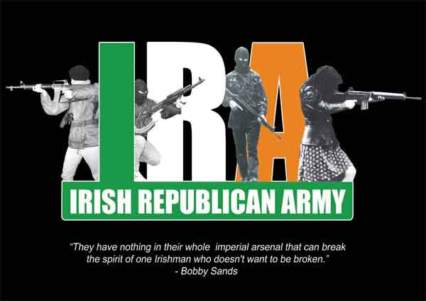
Risks to the UK

Slide 9
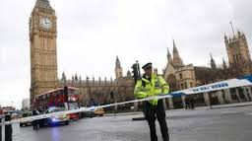
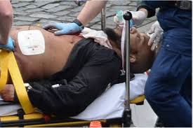
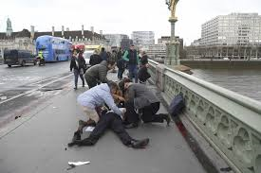
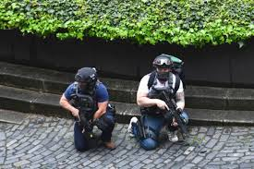
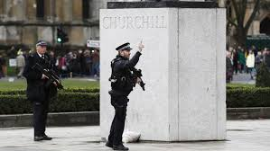
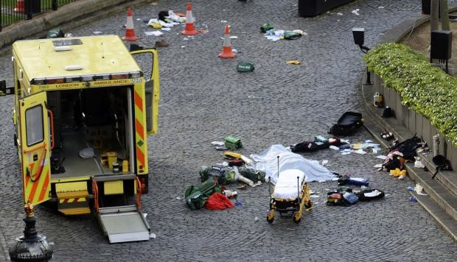
London – 22nd March 2017
Notes:
PC Keith Palmer
Aysha Frade

Slide 10
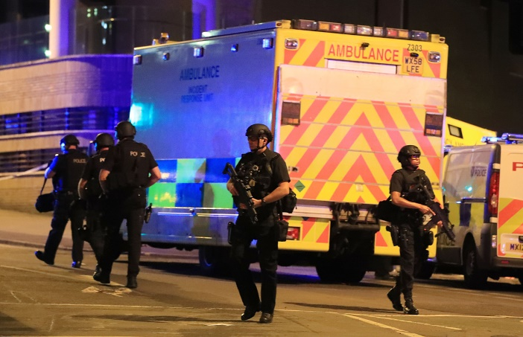
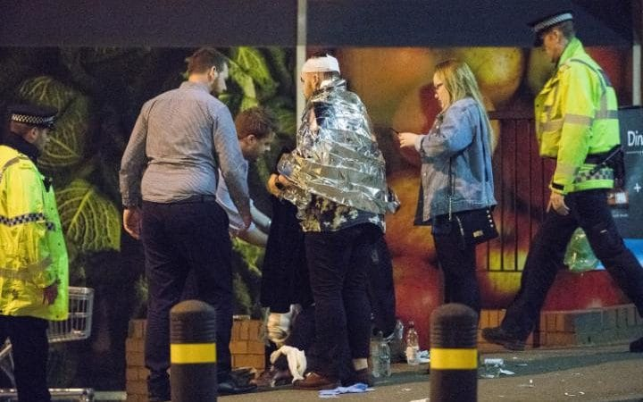
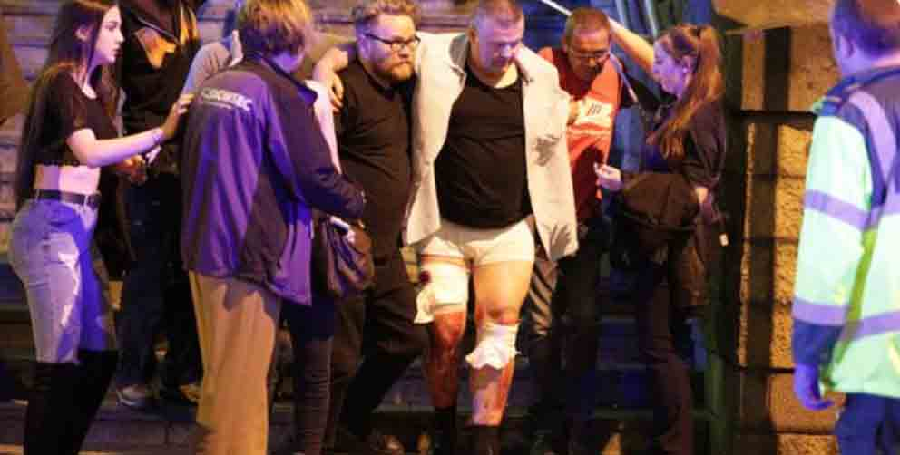
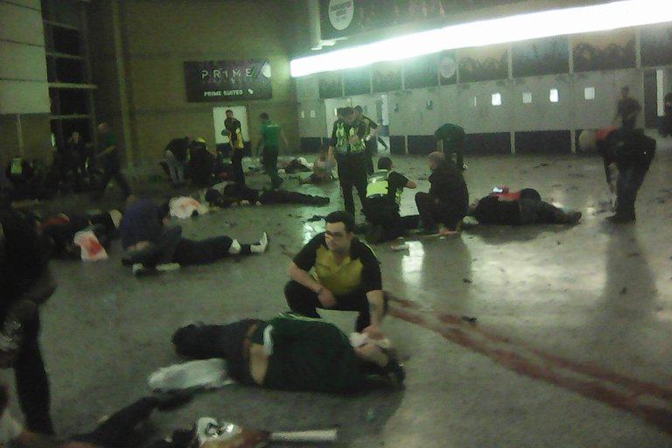
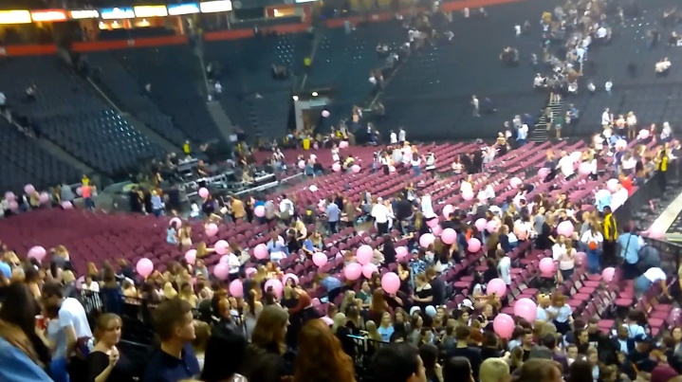
Manchester 22nd May – 22 People Killed

Slide 11
Risks to the UK
  International Terrorism
  Those returning from Syria and supporting the ideology of Islamic State - DAESH
  Tension between India and Pakistan regarding Kashmir
  Al Muhajiroun (ALM) Still actively recruiting people and driving lots of Anti UK narrative, glorify terrorism acts and encourage people to take action, Aman Choudry was released from prison in October 2018
  Domestic Extremism
  Extreme Far Right (unlawful) and Far Right Groups (lawful)
  Extremism in Prison and Secure Estate
  Online Extremism
  Lone Actors – Linked particularly to ERW

Slide 12
DAESH
Significant risk remains from DAESH
People travelling to and returning from Syria and other conflict zones.
People raising money for the “cause” in Syria and Iraq.
People being radicalised online – particular focus on the vulnerable and the lonely.

Slide 13
RISK FROM ISIS
Very sophisticated communication Network across the world in local languages and using all types of Social Media.
Target Young People and those who are vulnerable.
Also clear risk from Cyber Crime and hacking both from Terrorists and State Sponsored.

Slide 14
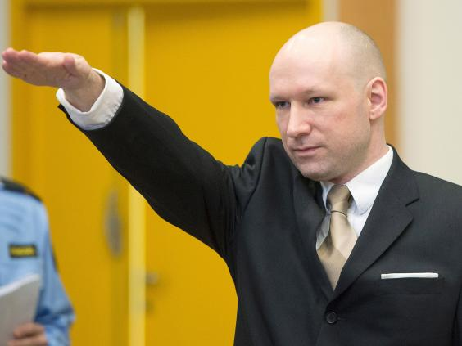
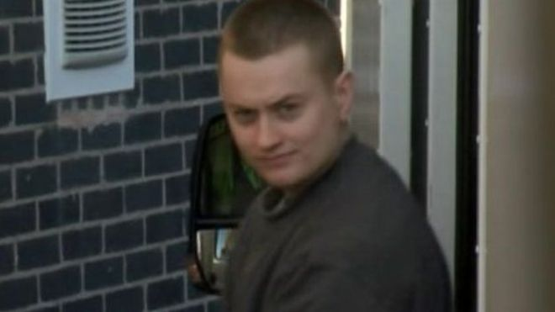
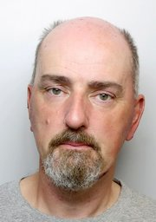
The Rise of the Far Right
Anders Breivik - Norway
Zack Davies- Attacked a Muslim Doctor in Tesco’s in Wales
Thomas Mair – Killed the MP Jo Cox
Far Right Inspired Incidents are increasing across Europe and the UK

Slide 16
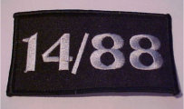
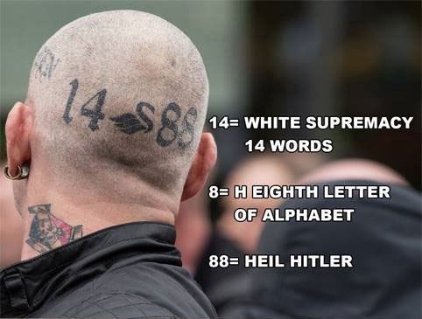

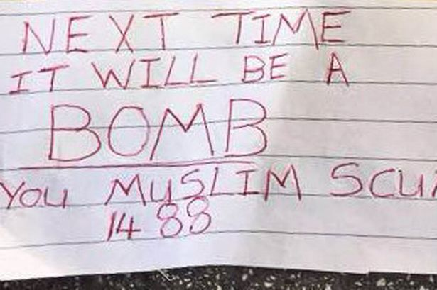
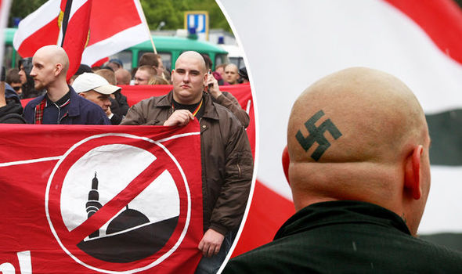
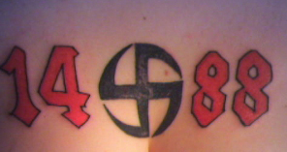
14/88

Slide 17
National Action
National Action (NA) are an Extreme Right Wing (XRW), neo-Nazi, British Nationalist Socialist group.
As of 16thDecember 2016 National Action have been proscribed by the Home Office under the Terrorism Act 2000.
They demonstrated openly racist, anti-Semitic and homophobic views, largely inspired by Adolf Hitler and the Nazi regime.
The group spread its ideology through Social Media, stickering, leafleting, graffiti and street demonstrations.
NA have carried out recruitment campaigns to increase their membership. They ran a campaign online to specifically recruit female members, the “Miss Hitler” competition, and they have carried out stickering and leafletting across the UK.

Slide 18
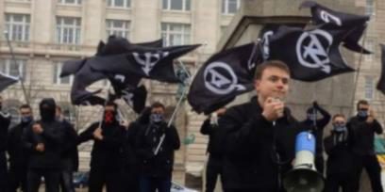




Slide 19


If you suspect report it.
Call the police Complete
confidentially the online form
on 0800 789 321. OR act.campaign.gov.uk

Slide 20
Channel and Referral Process

Slide 21
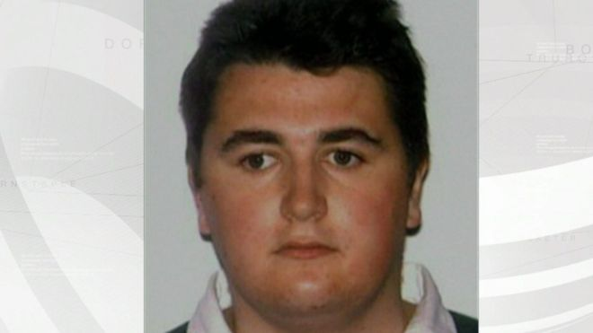
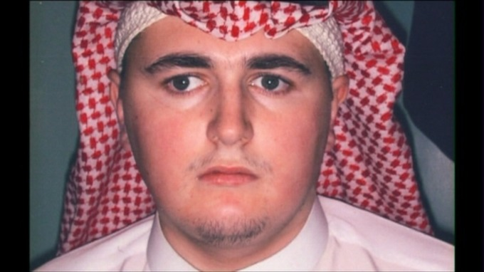
Case Study – Nicky Reilly

Slide 22
Case Study
Nicky Reilly was a 25 year old man from Exeter he had Asperger's and Learning Difficulties.
He was well know in Exeter and was know to be particularly fond of children (in a positive way)
In 2007 he tried to join the Merchant Navy and was turned down. This was a significant blow to him and seen as a turning point.
He went into an online forum and talked about how lonely and lost he was.
Islamic fundamentalists who were monitoring the forum, talked to him about ISLAM and exploited and radicalised him over a number of weeks.
He converted and took the name Mohamed Abdul-Aziz Rashid Saeed- Alim (in reference to the 9/11 attackers)
He was convinced to build a bomb and let it off in the Giraffe Restaurant in Exeter (Giraffe being seen as a symbol of western decadence and also a Jewish company)

Slide 23
On arrival at the restaurant he discovered it was Half Term and he panicked as the restaurant was full of families and children.
He eventually went into the toilets (after going to the back of the queue several times)
He detonated his bomb, but it didn’t work properly and only he was injured
It was declared a major incident and Exeter City Centre was evacuated and he was arrested.
He was sentenced to life imprisonment with a minimum term of 18 years in 2008.
On 20th October 2016, Nicky took his own life at HMP Manchester he was 30 years old.
No other person was ever convicted of any offences in relation to this and the people who radicalised him online were never found.

Slide 24
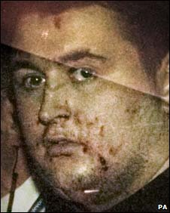
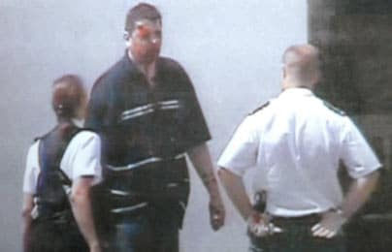
How Could We Intervene?

Slide 25
If you suspect report it.
Call the police Complete
confidentially the online form
on 0800 789 321. OR act.campaign.gov.uk

